Slide 1

Empowering-Employee-Wellness-A-RealTimeStressMonitoring-System

Slide 2
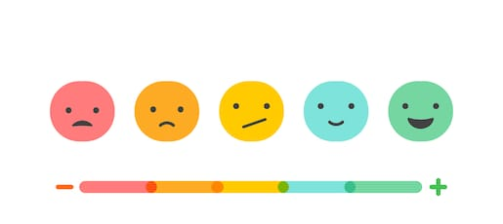
We Propose
An Efficient and User Friendly way to monitor employee satisfaction and participation levels in the projects!
We seek to identify and boost morale of passive employees by collecting information in an unobtrusive manner.
This will help in understanding each employee! AI helpz.
.

Slide 3
How Do We plan to achieve this ?

Slide 4
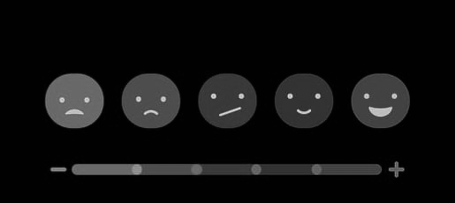
Employee-Emotion Based Job Satisfaction Levels Prediction
1

Slide 5
Passive Employee Engagement identification using Audio Processing – The Meeting Suite
2

Slide 6
Project objective
A Solution for ALL that revolutionizes the Corporate Ecosystem .
We aim at overcoming the pitfalls of the human errors prevalent among all the employee engagement systems all over the world.
We propose to build a fully automated, AI based system overcoming the challenges in the present systems. n

Slide 7
Proposed solution
1
The concept behind the system is to actively monitor the employee’s emotion levels (Directly Propotional to the job satisfaction), using a camera, during the login time . The emotion can then be analysed to provide further insights regarding his morale . (Happy, Sad, Neutral etc.)
The desired result is achieved using a combination of Image Processing Techniques and Deep Learning Interfaces .
The system achieves high accuracy within the given time .

Slide 8
Technical Description
1
We trained Inception V3, a Transfer learning based deep neural network which is capable of
Classifying the emotions of given input into Sad/Neutral/Happy. This shall let us know how much satisfied the employees are.
Estimate Age ranging from 1-99 in the required intervals.
Determine Gender whether its a male/female
The output of the model is stored in non-relational database for further analysis
System has 95% accuracy

Slide 9
Proposed solution
2
We have also built a system that is able to accurately detect and transcript dialogues from meetings using Audio Processing and AI Techniques.
The system is able to associate voices with individuals with relative ease , The idea is to track all the employees engagement in meetings over a period of time and to establish a clear pattern of disengagement.
This information can be further used by the organization as appropriate.

Slide 10
Technical Description
2
The model takes the audio of the recorded meeting as input and undergoes sequential process of feature extraction, speech segmentation, speech recognition and speaker diarization so that we can get complete detailed information about the recorded meeting. The system is 97% accurate.

Slide 11
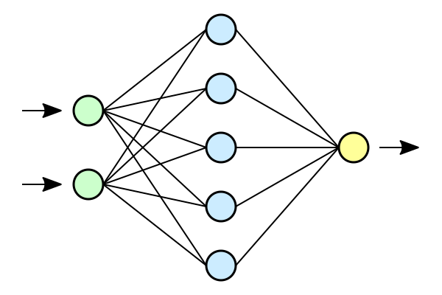




Architecture Diagram:
1
Happy
Emotion Recognition
Server
Face Localization
Neutral
Age Estimation
Angry
Let’s Capture
Gender Recognition
Transfer Learning based Deep Neural Network with Inception V3
Firebase
Store the Feedback Data in the database.

Slide 12
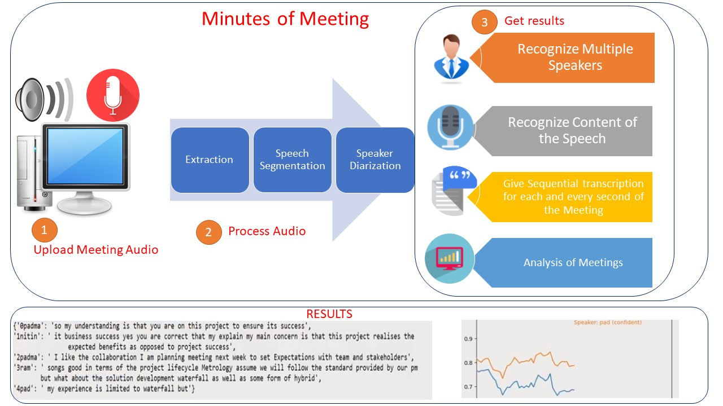
Architecture Diagram:
2

Slide 13


Technology Stack
Interfaces
React JS Frontend Framework
1
Middleware
2
Backend
Firebase
3

Slide 14
Privacy Taken Care
We delete the photos and audio uploaded immediately after the analytics and we do not store them thereby ensuring privacy.
This deletion frees us from memory requirements too.

Slide 15

Salient Features :
Highly Robust , can process all inputs with relative ease .
The entire ecosystem is Plug-and-Play , hence the user experience and ease of adoption is quite high .
Highly accurate Diagnosis .(97%)
Scalable as the entire system can be made to run on the cloud , and results are obtained in a quick manner .

Slide 16
It’s more meaningful engagement, now!

